Slide 1




Virtual Academy Grades 7-12
2024-2025 School year!
UCS VA Student Handbook & Expectations Overview

Slide 2



What we are covering today:
Student Health & Attendance
Instructional Programs & Coursework
Student Expectations & Communication
Discipline & Code of Conduct

Slide 3

01
Student Health & Attendance
Students are expected to attend school every day, if possible. Helping maintain good health of every student is the concern of all UCS teachers and administrators. Students who become ill must report their absence to the home building to help ensure accurate attendance.

Slide 4
Did you know?
Reporting a student’s absence
Students are expected to attend, be on time and prepared for class every day.
If a student (grades 9-12) accumulates more than 10 absences they will be placed on Credit Review
If a student (grades 7-8) accumulates more than 10 absences a truancy report may be filed .
Please call your home school to report and absence or early dismissal. [Before school begins]
Students are responsible for contacting their teachers to receive work missed.
Students are responsible for making arrangements in advanced for pre-arranged absences from a particular class.

Slide 5
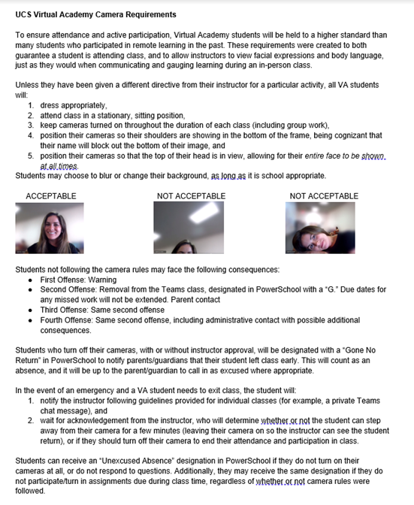
Camera Expectations

Slide 6
Absences- Grades 7-8
Please see student handbook pg. 60
Pre-excused absence- should seek approval prior to absence
Vacation absences of more than 10 days will not be approved
Excessive absences- pg. 62 of the handbook

Slide 7
Student Health & Attendance
Grades 7-8
When a student has accumulated 11 absences* in any one class over the course of a semester, a letter will be sent via email (or U.S. mail if no email address on file) stating that the student’s absences have become excessive, which may result in a referral to a truancy office.
When a student has accumulated between seven and 10 absences* in any one class per semester, the student’s assistant principal will meet with the student.
The assistant principal may use this opportunity to discuss any class that is at five absences or more.. A letter signed by the student and assistant principal will be scanned and emailed home (sent United Staes mail if no email address on file).

Slide 8
Absences- Grades 9-12
Please see student handbook pg. 63
Pre-excused absence- should seek approval prior to absence
Vacation absences of more than 10 days will not be approved
Credit Review due to chronic absenteeism- pg. 64 of the handbook

Slide 9
Student Health & Attendance
Grades 9-12
The assistant/associate principal may use this opportunity to warn for any class that is at five absences or more (the warning should be added to the letter that will be sent home, there will not be an additional meeting when the student reaches seven to 10 absences in those classes). A letter signed by the student and assistant/associate principal will be scanned and emailed home (mailed in the case of no email address on file). •
When a student has accumulated 11 absences* in any one class over the course of a semester, the student will be notified in a meeting with an assistant/associate principal that they have lost credit in that class and that they are placed on an attendance contract to earn the credit back.
When a student has accumulated between seven and 10 absences* in any one class per semester, the student’s assistant/associate principal will meet with the student.

Slide 10
Restoring Credit (Grades 9-12) when on an Attendance Contract…
A meeting is held with the Assistant/Associate Principal when a student has accumulated 11 absences he/she has lost credit and placed on an attendance contract.

Slide 11
Trying to restore credit (Grades 9-12)…
STUDENTS WHO FAIL TO MEET THE ATTENDANCE CONTRACT WILL BE GIVEN A SEMESTER GRADE OF AN F.
Meet with Assistant/Associate Principal
Agree, in writing, to an attendance contract to earn the credit back
A letter will be sent via email (or US mail if no email on file) stating the student has lost credit and been placed on an attendance contract to earn the credit back,.
Attendance improvement is based on a sliding scale of 1 absence per three weeks- see pg. 65 in the handbook
Attendance Contract Part 1
Student must pass the class with a D- or higher
Attendance Contract Part 2
The student must show improvement in attendance in ALL classes.
Check out the entire attendance & credit review policy in the student handbook!

Slide 12
02
Instructional Coursework & Programs
Utica Community Schools offers students broad curriculum choices in planning for future education and careers. You should make thoughtful decisions when selecting courses, keeping in mind that you should challenge yourself and strive for excellence. Contact the counseling department with questions or concerns regarding course selection. You may also view secondary curriculum choices on the UCS website under Academics.

Slide 13
Did you know?
Subject Area | Credit(s)
English Language Arts | 4.0 credits
Mathematics | 4.0 credits
Science | 3.0 credits
Social Studies | 3.0 credits
Health and Physical Education | 1.0 credit
Visual, Performing, Applied Arts, CTE | 1 credit
Online Learning Experience
World Languages | 2.0 credits
Personal Finance | 0.5 credit (Starting with the Class of 2028)
Michigan Merit Exam
22 credits for Graduation. One-half credit is granted for each course.
Additional information regarding a personal curriculum or modifications is available at: Secondary / UCS Graduation Requirements (uticak12.org)

Slide 14
03
Student Supports
UCS provides many opportunities for student support. Our goal is to offer assistance for our students' physical, mental, social, and academic needs.

Slide 15
Resources
School counselor
School administration
VA Website for updates
UCS Virtual Academy / Homepage (uticak12.org)
Please contact your home school to determine your counselor.
Please contact your home school to determine your administrator.
Virtual library card
UCS Wellness
Tech Support
UCS Wellness / Resources (uticak12.org)
UCS Tech / Home (uticak12.org)
Virtual Library Card.pdf (uticak12.org)

Slide 16
04
Discipline & Code of Conduct
A student’s right to a public education carries with it a responsibility to know and observe school rules. These rules help minimize distractions which disrupt learning and help to maintain a safe educational environment. Board of Education policies and in some instances, state law, establish behavioral expectations and consequences for violations. While all students have rights and privileges, all are expected to act in a reasonable manner at all times, during school and during all school activities.

Slide 17
Did you know?
As a virtual student you are expected to abide by the student policies and procedures established by Utica Community Schools.

Slide 18



Pathway to Restorative Action
1st
2nd
3rd
Teacher & Parent Contact
**For complete information please refer
to the complete disciplinary guide in the student handbook.**
Home School Assistant/Associate Principal mediation
Disciplinary Action & Disciplinary Process

Slide 19

Thank you!
Questions
Dr. Heather Blum
Director of Student Services
Heather.blum@uticak12.org

Slide 20
Credits.
Creators: Mrs. Acoff and Dr. Blum
Presentation Template: SlidesMania
Images: Unsplash
Fonts used in this presentation: Coming
Soon and Chelsea Market

